Slide 1
SSIS Project
Author : Biswajit Banerjee

Slide 2
CASE STUDY
Need to load data from CSV file to SQL Server Table using SSIS.
Rename CSV file with date time. (ABC.txt → ABC.txt-2024_03_05)
Need to move file from source to archiver
Need to match loaded data with other table
Matching data should export to Excel file from SQL server
Set up a job in job activity monitor list in SSMS
Schedule this Job to execute the package automatically.

Slide 3
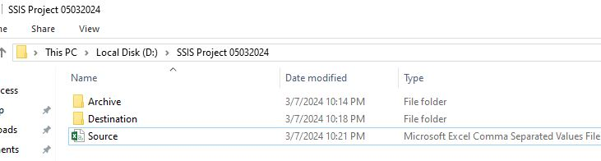
We have taken a .CSV file named as Source.csv and create two separate folder Archive and Destination for future

Slide 4
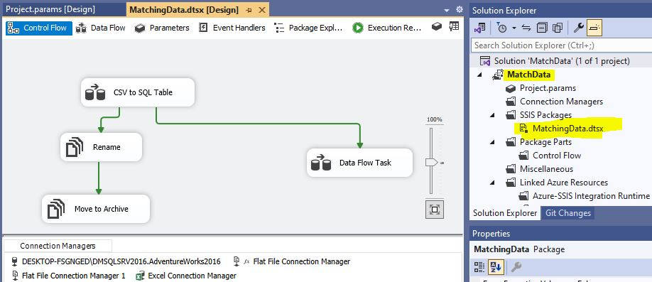
We Created a Project “MatchData” inside which we created “MatchingData.dtsx” SSIS package. Now inside this package we have taken two Data flow task and two file system task. One file system task named as “Rename” and another “Move to Archive”

Slide 5
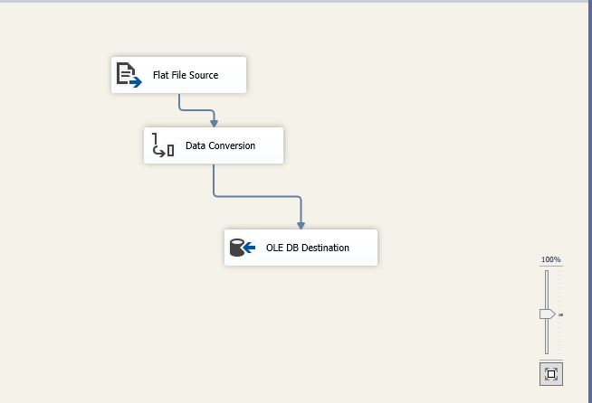
Inside “CSV to SQL Table” data flow task we have taken one Flat file Source, one Data Conversion task and a OLE DB Destination.

Slide 6
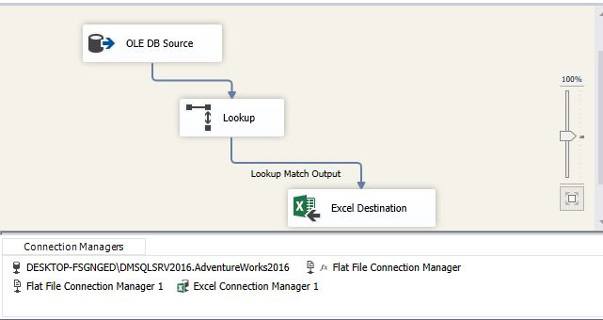
Inside another data flow task we have taken one OLE DB Source, one Lookup task and a Excel Destination. That Excel will be kept at destination folder with Match output.

Slide 7
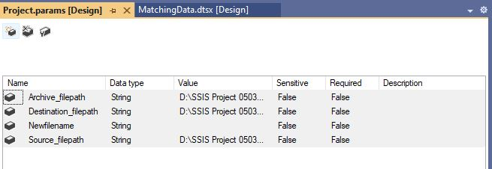
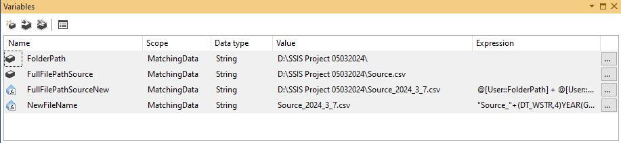
Declaring Parameters and Variables to make the package dynamic.

Slide 8
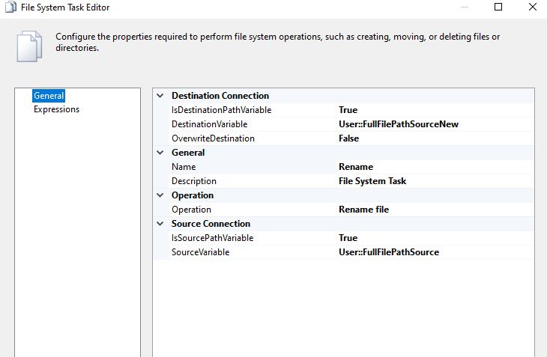
Configuring File system task called “Rename”

Slide 9
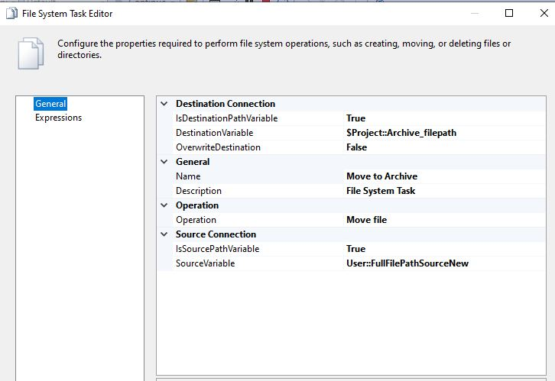
Configuring File System task called “Archived”

Slide 10
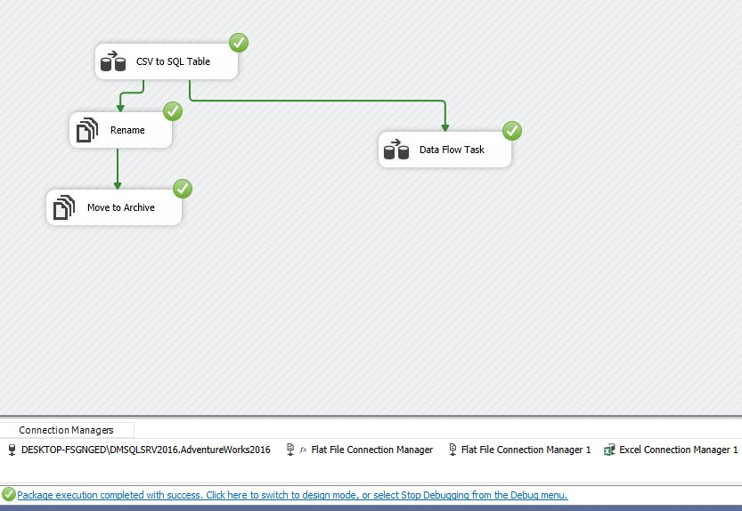
Starting Package and it executed error free

Slide 11
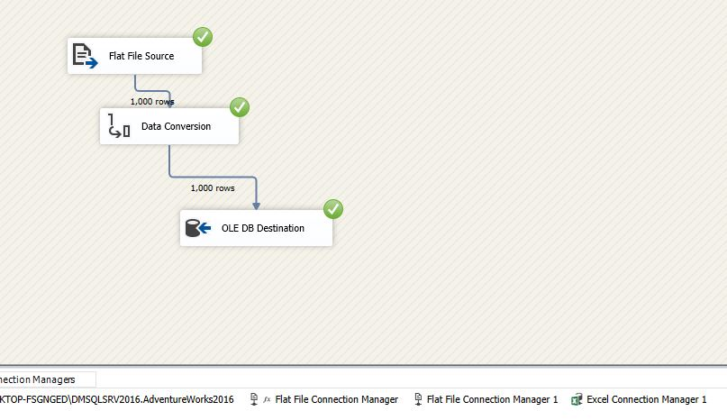
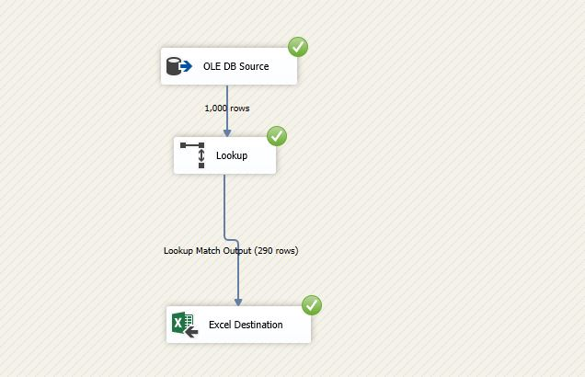
Total 1000 row inserted into [dbo].[EMPDetails] table among which only 290 row matched with [HumanResources].[Employee] table.

Slide 12
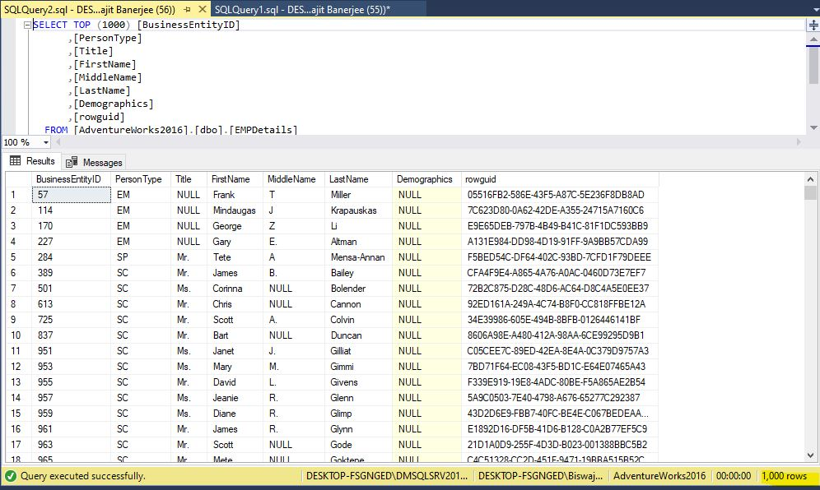
Output Result of SQL table [dbo].[EMPDetails]

Slide 13
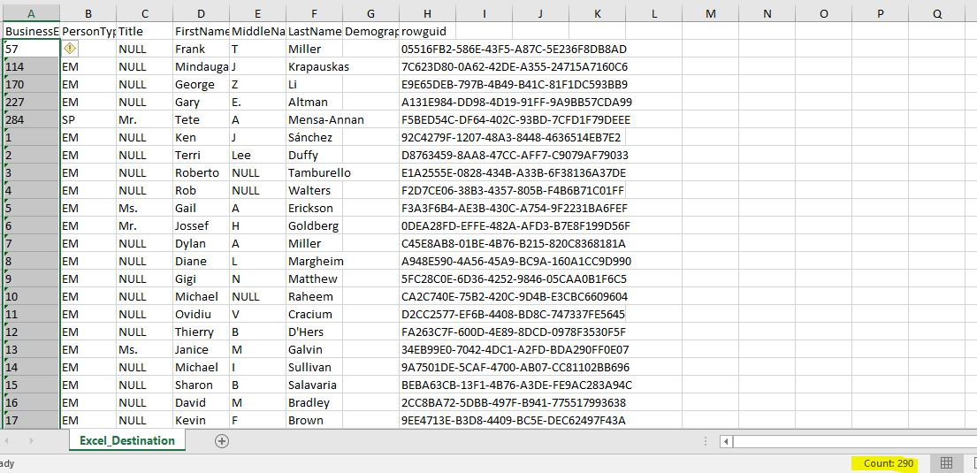
Output of Match List Excel file created in destination folder.

Slide 14
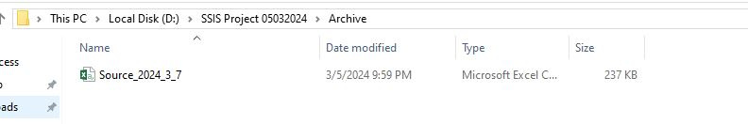
We can see the Source file moved to the folder “Archive” after renaming “Source_YYYY_MM_DD”.

Slide 15
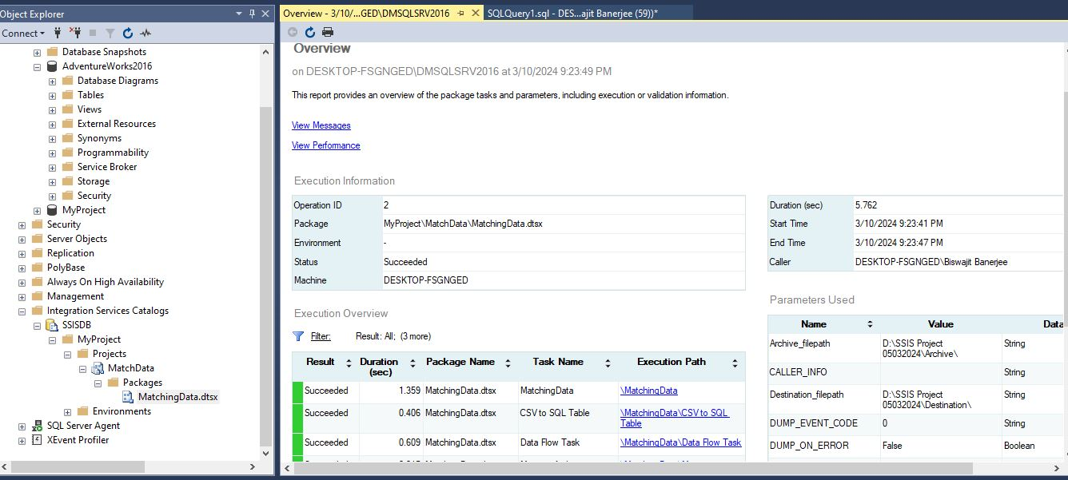
We have deployed this project “Matchdata” inside SSMS integration service catalog by using .ispac setup file and ran it manually to check test result.

Slide 16
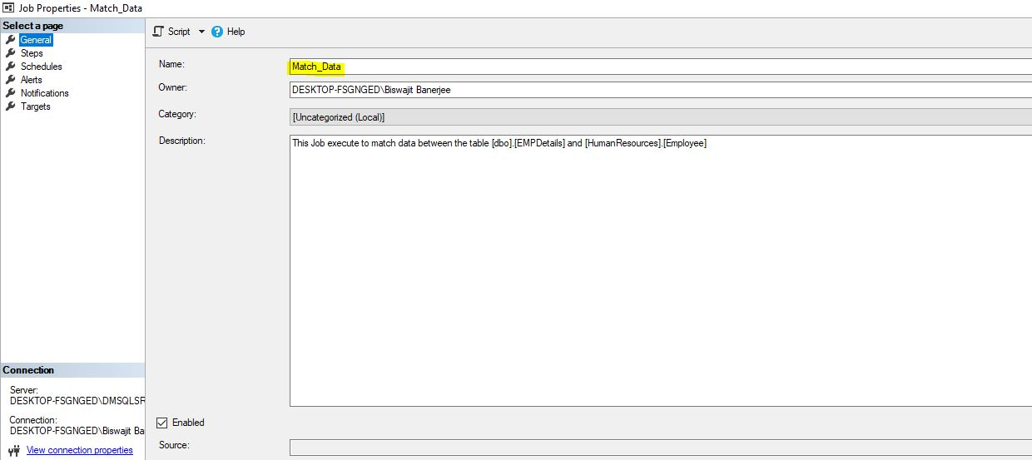
Now we created a Job name “Match_Data” inside SSMS Job list.

Slide 17
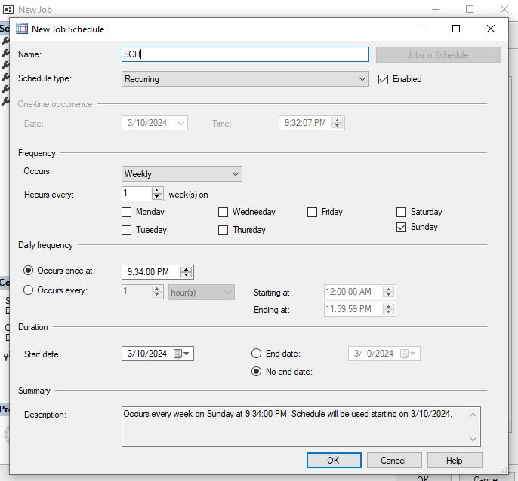
We have schedule this job for every Sunday at 09:34 PM occurring once at a time.

Slide 18
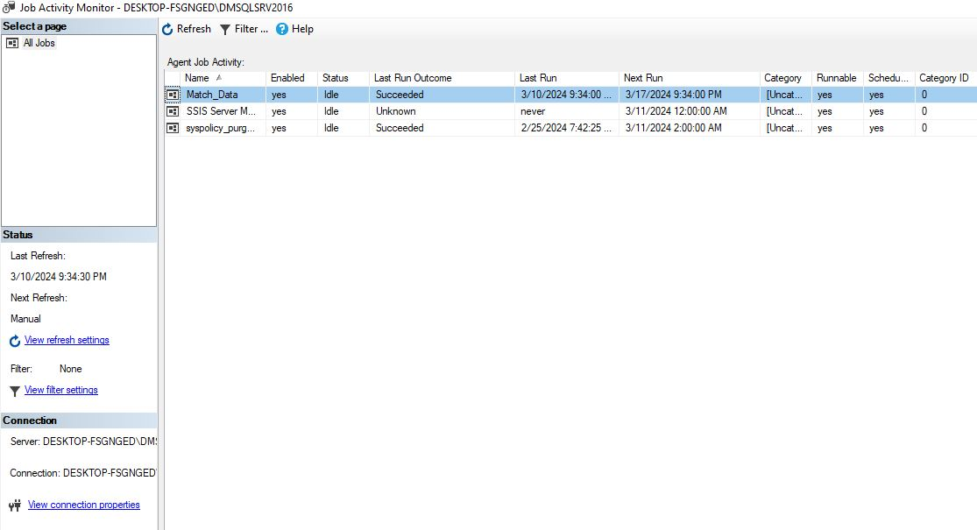
Job “Match_Data” ran Successfully.

Slide 19
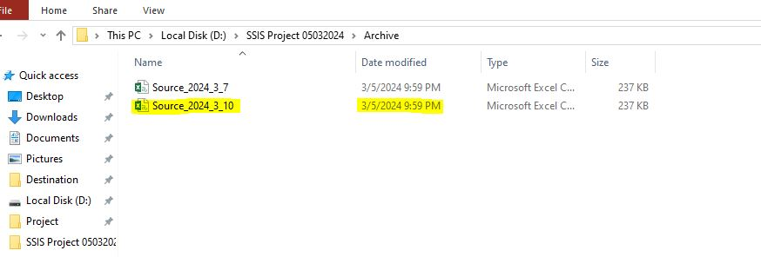
As a result another Source file moved to “Archive” folder after renaming.

Slide 20

Thank You !
Let Me Know If any doubt

